Slide 1
Machine Learning DASC 522
Neural Network Foundations & Processes
Dr. Torrey Wagner

Slide 2
Overview
Big Picture
Background & Structure
Perceptrons
Perceptron Learning
Artificial Neural Networks (ANN or NN)
NN Learning
Optimization
Regularization

Slide 3
Big Picture

Slide 4
A bit of fun…

Slide 5
Python Implementation

Slide 6
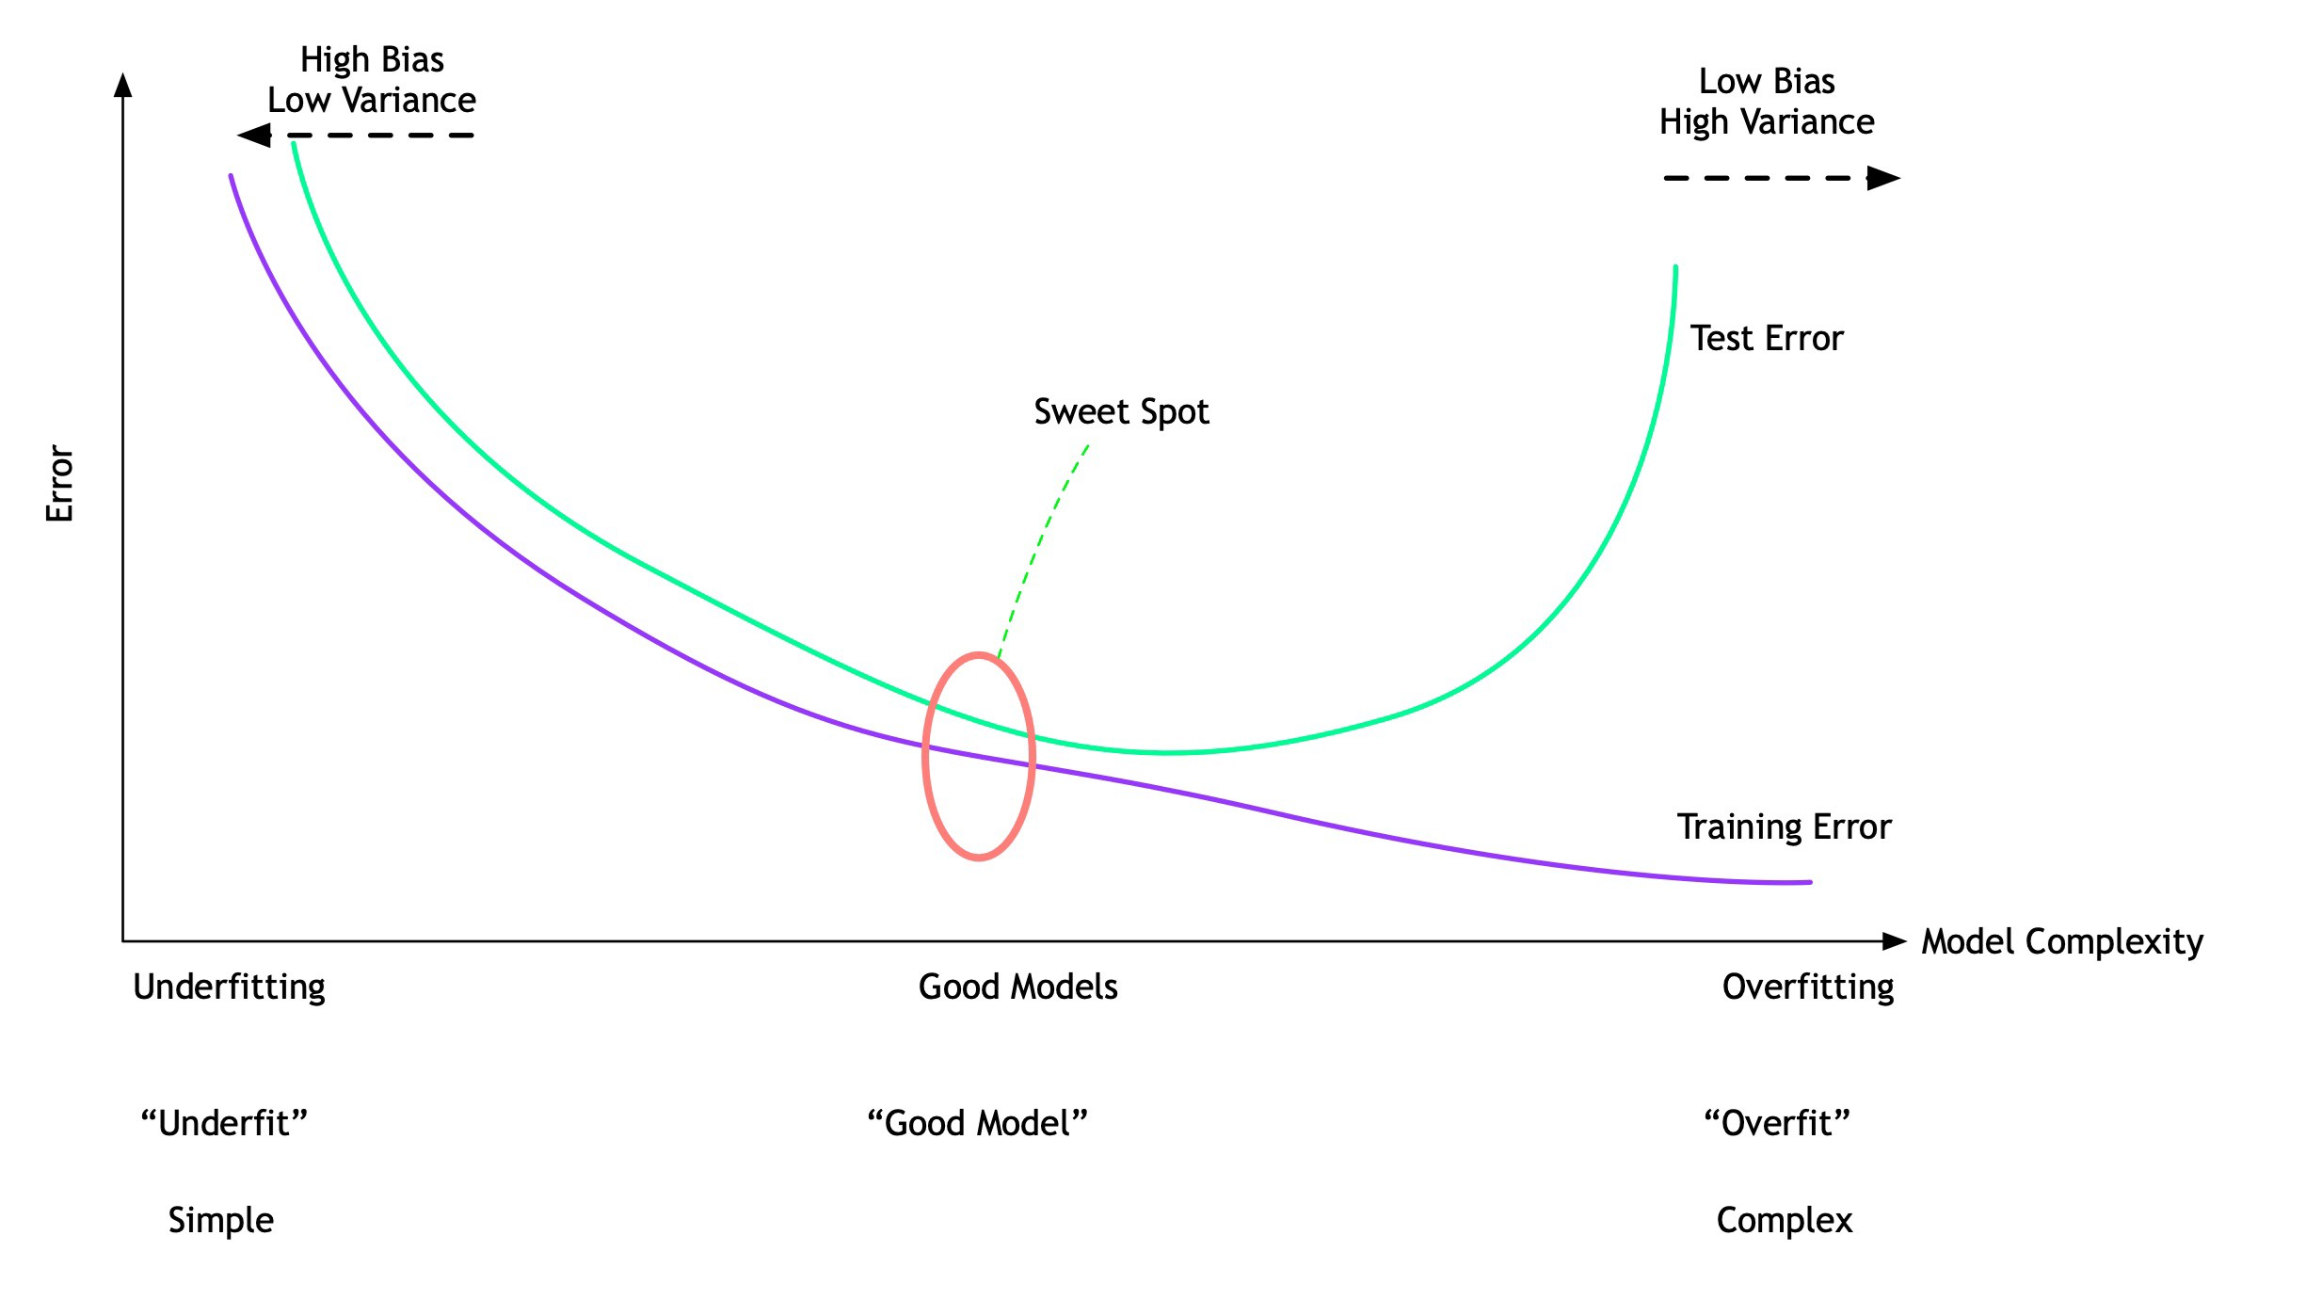
Model Continuum
https://towardsdatascience.com/data-science-simplified-part-12-resampling-methods-e029db77fa9c

Slide 7
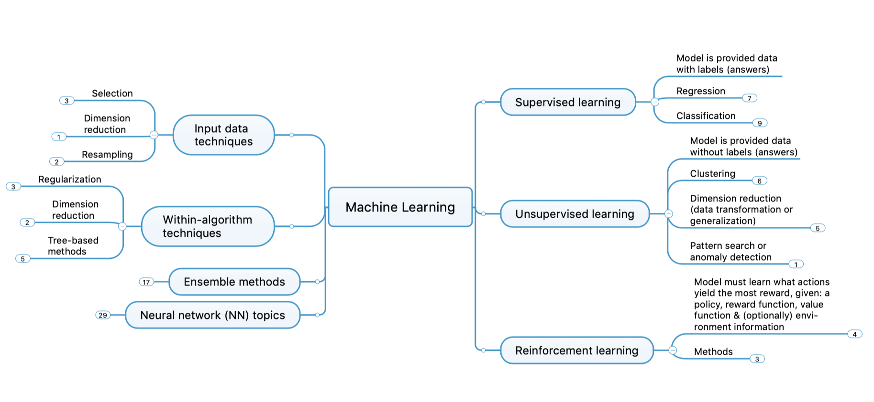
Concept Map

Slide 8
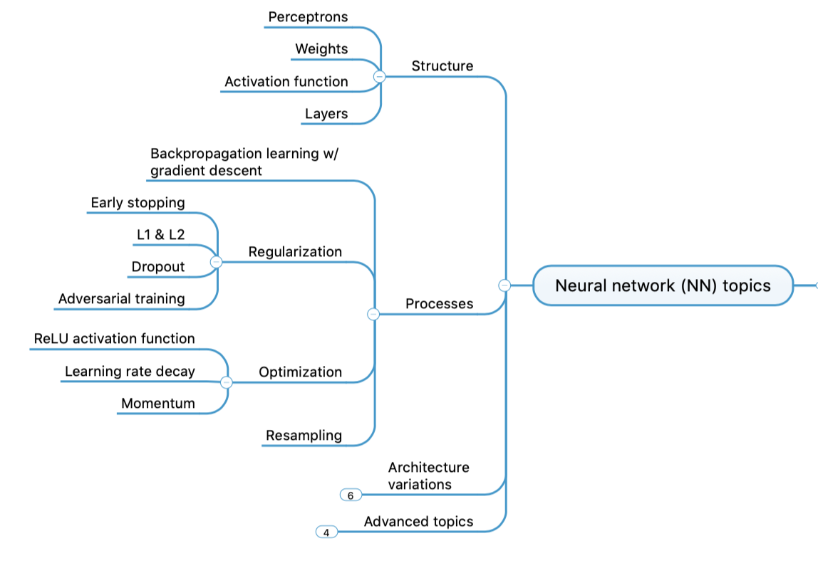
Concept Map - NN

Slide 9
Machine Learning DASC 522
Neural Network Foundations & Processes
Dr. Torrey Wagner

Slide 10
Overview
Big Picture
Background & Structure
Perceptrons
Perceptron Learning
Artificial Neural Networks (ANN or NN)
NN Learning
Optimization
Regularization

Slide 11
Background
&
Structure

Slide 12
Artificial Neural Networks What are ANNs?
Biologically-inspired computing methods
Engineering models of the human brain
They model some aspects of the brain…
…but not all
Slide from Dr. Brett Borghetti, AFIT/ENG CSCE 823 Advanced Machine Learning, 2019SU

Slide 13
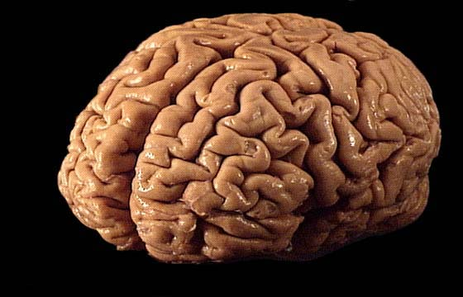
The Brain…
Factoids :
Average weight is 3lbs, 2% of your body weight
Has approx 100B neurons
Average Dimensions: 5.5”x6.6”x3.7 (WxLxH)
Cortex average area: 2.5ft²
12 Cranial Nerves
https://faculty.washington.edu/chudler/flash/facts.html
Slide from Dr. Brett Borghetti, AFIT/ENG CSCE 823 Advanced Machine Learning, 2019SU

Slide 14
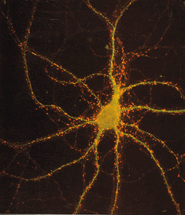
Neuron Facts
Some facts
Data rate: 50 Baud (slow!)
Neuron switching time : > 10⁻³ secs
Connections (synapses) per neuron : ~10⁴–10⁵
In Applications
Face recognition : 0.1 secs
Speed comes from the possibility of:
High degree of parallel computation
Distributed representations
Slide from Dr. Brett Borghetti, AFIT/ENG CSCE 823 Advanced Machine Learning, 2019SU

Slide 15
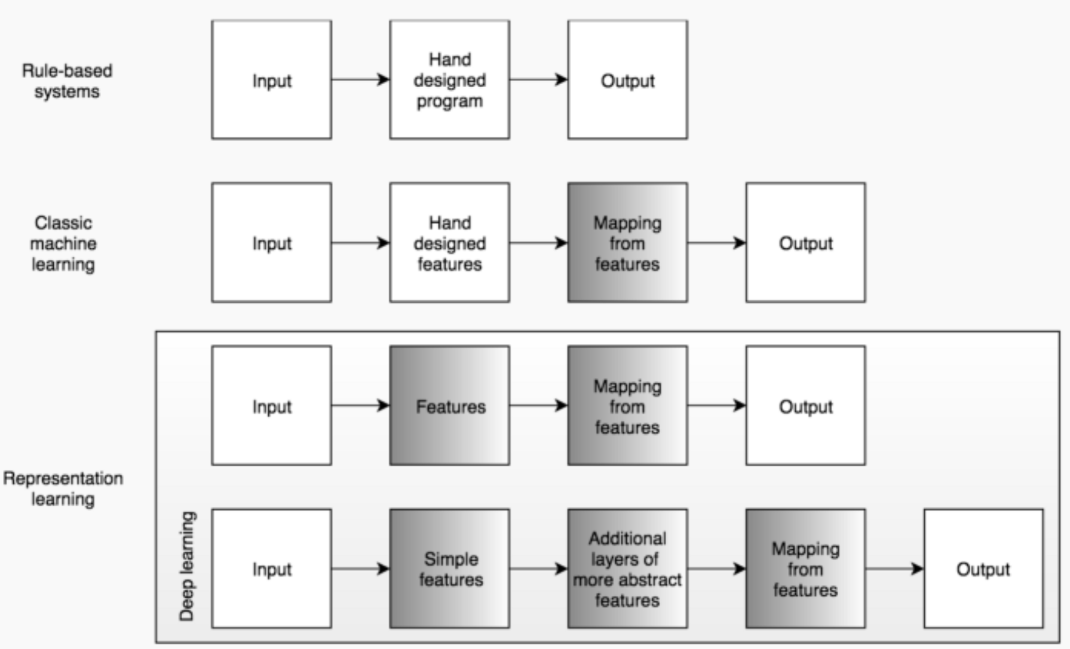
Types of Learning

Slide 16
Deep Learning Basics
Perceptrons
ANNs
Regularization & Optimization
CNNs
RNNs
Staring with perceptrons, we will build up ANNs and finally deep network architectures
Training deep networks requires special techniques for regularization and optimization
Slide from Dr. Brett Borghetti, AFIT/ENG CSCE 823 Advanced Machine Learning, 2019SU

Slide 17
Artificial Neuron (Perceptron)
x₁
W₁
Neuron
INPUTS
W₂
Σ
f(n)
Outputs
W
Activation
Function
W
W=Weight
A Brief Overview on Neural Networks - Smart Engineering smarteng.mst.edu › smarteng › documents › EE401_new

Slide 18
Perceptron Animation
animation at https://appliedgo.net/perceptron/

Slide 19
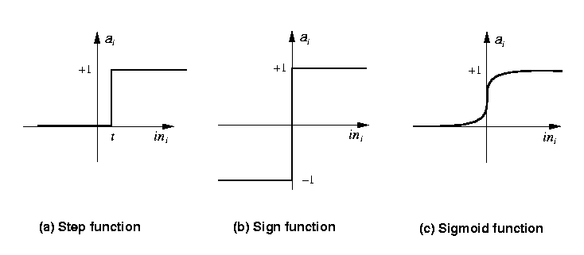
Activation Functions
Step_{t}(x) = 1 if x >= t, else 0
Sign(x) = +1 if x >= 0, else –1
Sigmoid(x) = 1/(1+e^{-x})
ReLU
www.cs.nott.ac.uk › ~pszgxk › aim › ppt › neuralnetw...

Slide 20
Types of networks
Multiple Inputs and Single Layer
Multiple Inputs and layers
A Brief Overview on Neural Networks - Smart Engineering smarteng.mst.edu › smarteng › documents › EE401_new

Slide 21
Types of Networks
Feedback
Recurrent Networks
A Brief Overview on Neural Networks - Smart Engineering smarteng.mst.edu › smarteng › documents › EE401_new

Slide 22
Convolutional Neural Networks
Main use: Image recognition
https://medium.com/@himadrisankarchatterjee/a-basic-introduction-to-convolutional-neural-network-8e39019b27c4

Slide 23
Visualization
https://developers.google.com/machine-learning/crash-course/introduction-to-neural-networks/playground-exercises

Slide 24
Signal Flow Backpropagation of Errors
Function Signals
Error Signals
A Brief Overview on Neural Networks - Smart Engineering smarteng.mst.edu › smarteng › documents › EE401_new

